Slide 1


Stroke free?
Stress free.
Save Yourself
By: Jaskirat, Jelena, Nicole & Yumai (Team 5)

Slide 2




Agenda
Q1: jlkljlakjdd Mini - hypothesis
Resource Visualization
Main Hypothesis
Name Data Cleaning
Name Introduction
Conclusion
Project 3:
Team 5
Name Visualization Libs
Name Statistics
Q2: jdsdhsadlj Mini - hypothesis
Resource Visualization
Q3: sjdljsajdlkajdlsajd Interactive

Slide 3

WORLD STROKE Organization projects a 50% rise in a stroke that will claim 9.7 million lives a year by 2050
Globally, 1 in 4 adults, over the age of 25 will have a stroke in their lifetime.
STROKE PREDICTORS Problem Statement:
How can patients of higher stroke risk be more easily identified through measurable, and potentially modifiable, metrics in lifestyle and health status?

Slide 4
Data Source: The healthcare-dataset- stroke-data.csv from Kaggle.com
The dataset includes various features related to patients’ health and lifestyle, including age, gender, hypertension, heart disease, marital status, work type, residence type, average glucose level, BMI, smoking status, stroke.
There are 5,110 patients in this dataset
Libraries used: Pandas, Nympy, MatPlotLib, JSON, Flask, Sqlite, SQLAlchemy, Plotly, D3
Languages used: Python, SQL, JavaScript, HTML, CSS

Slide 5
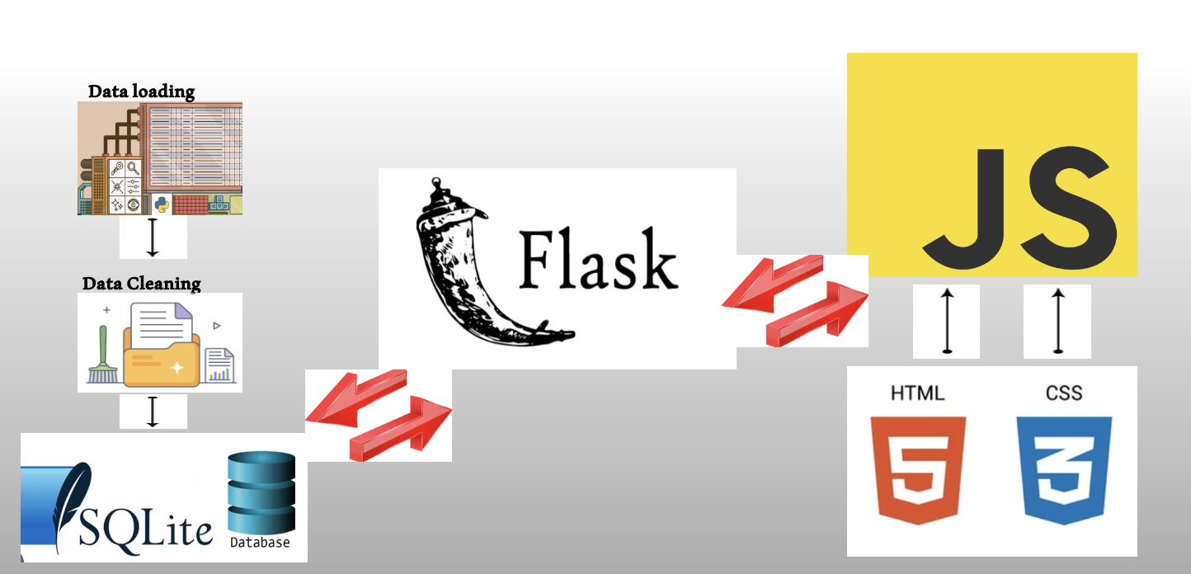
WORKFLOW DIAGRAM

Slide 6
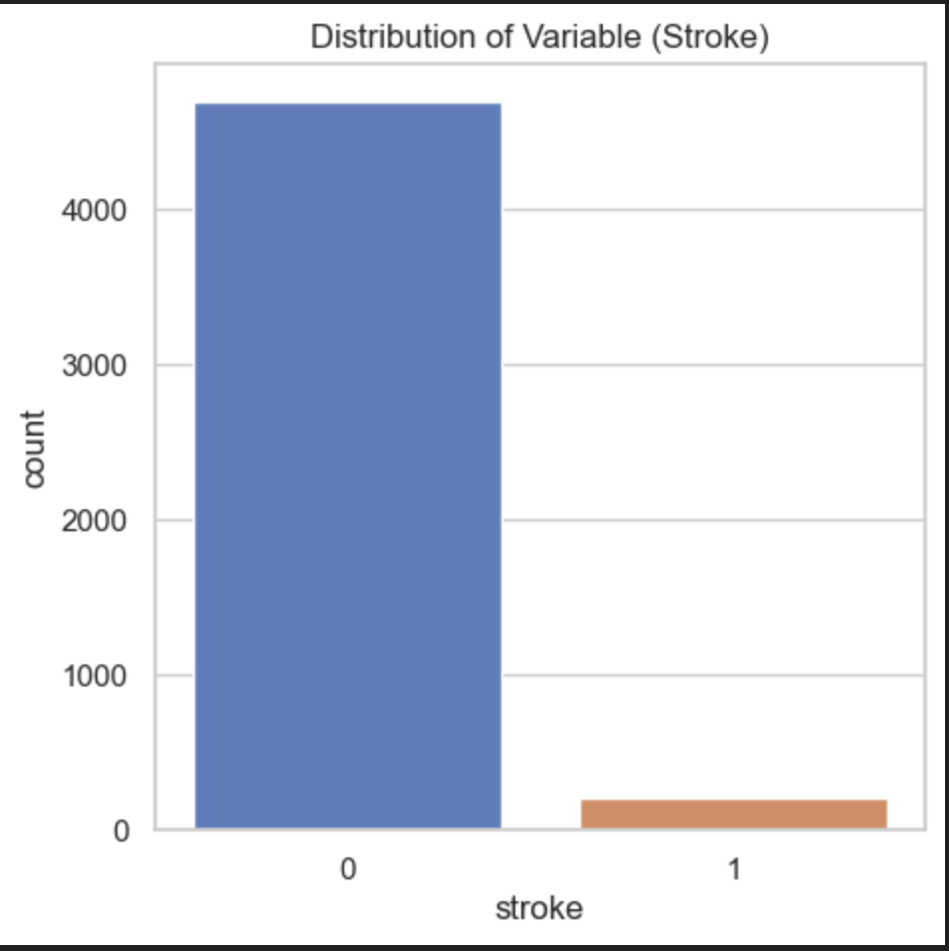
Variable stroke
highly imbalanced with a lot more instances of no stroke 0 than stroke 1
In this dataset there is total of 209 strokes out of 4,908 patients.

Slide 7
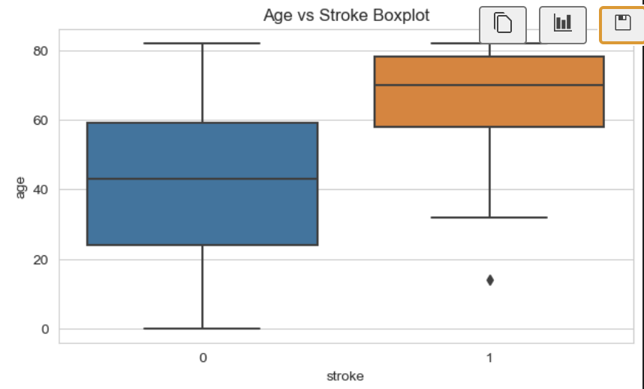
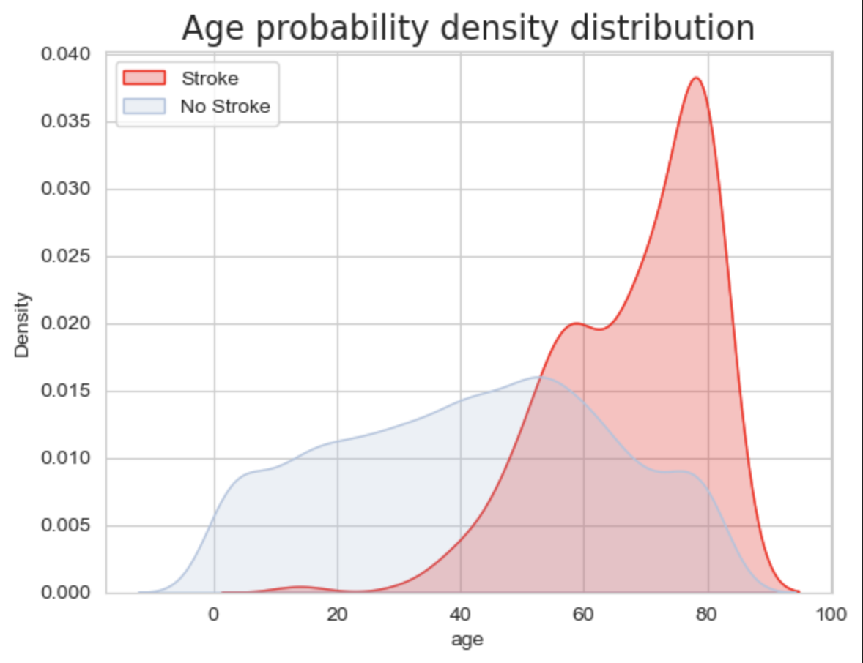
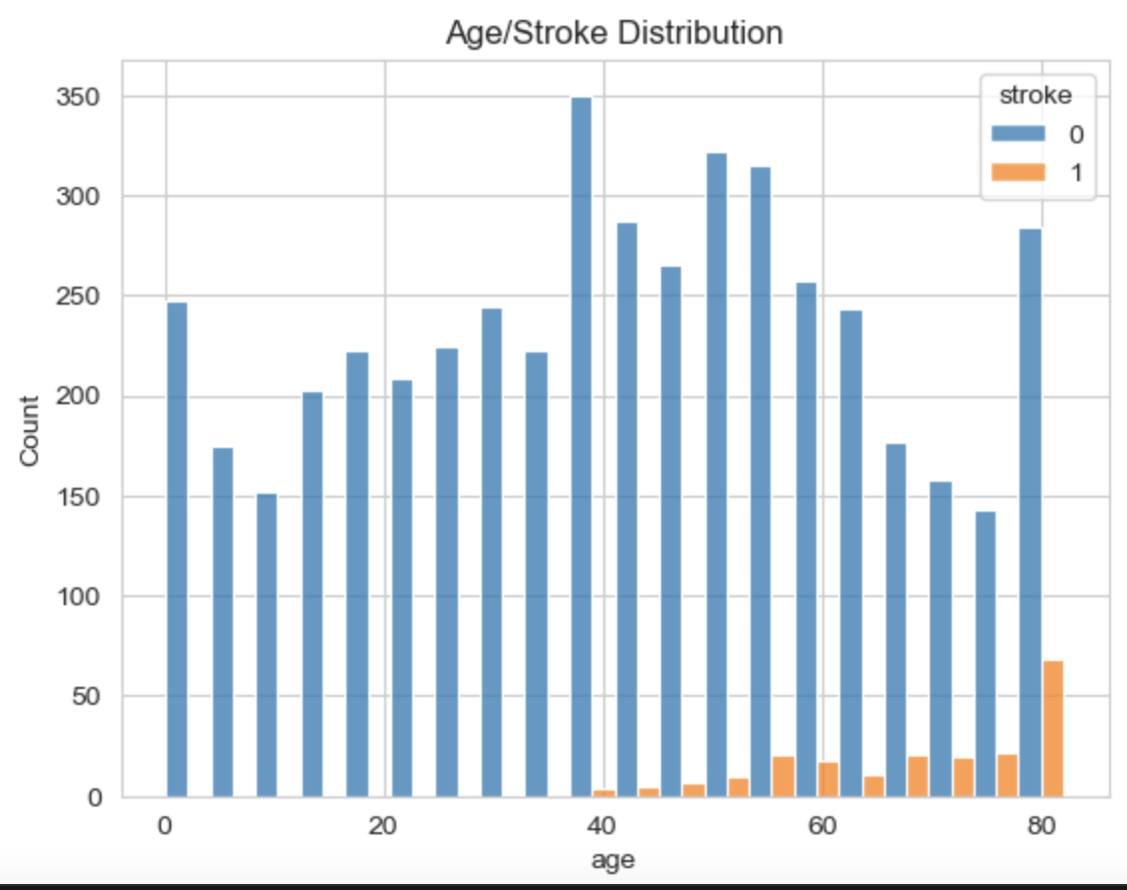
Age vs Stroke
The age of patients varies but majority of them are in the range of 40-80.
Stroke cases are more common in older patients. The median age of stroke patients appears to be higher than of non-stroke patient.
Aging has been identified to be the most robust non-modifiable risk factor for stroke, which doubles the risk every 10 years after 55 years.

Slide 8
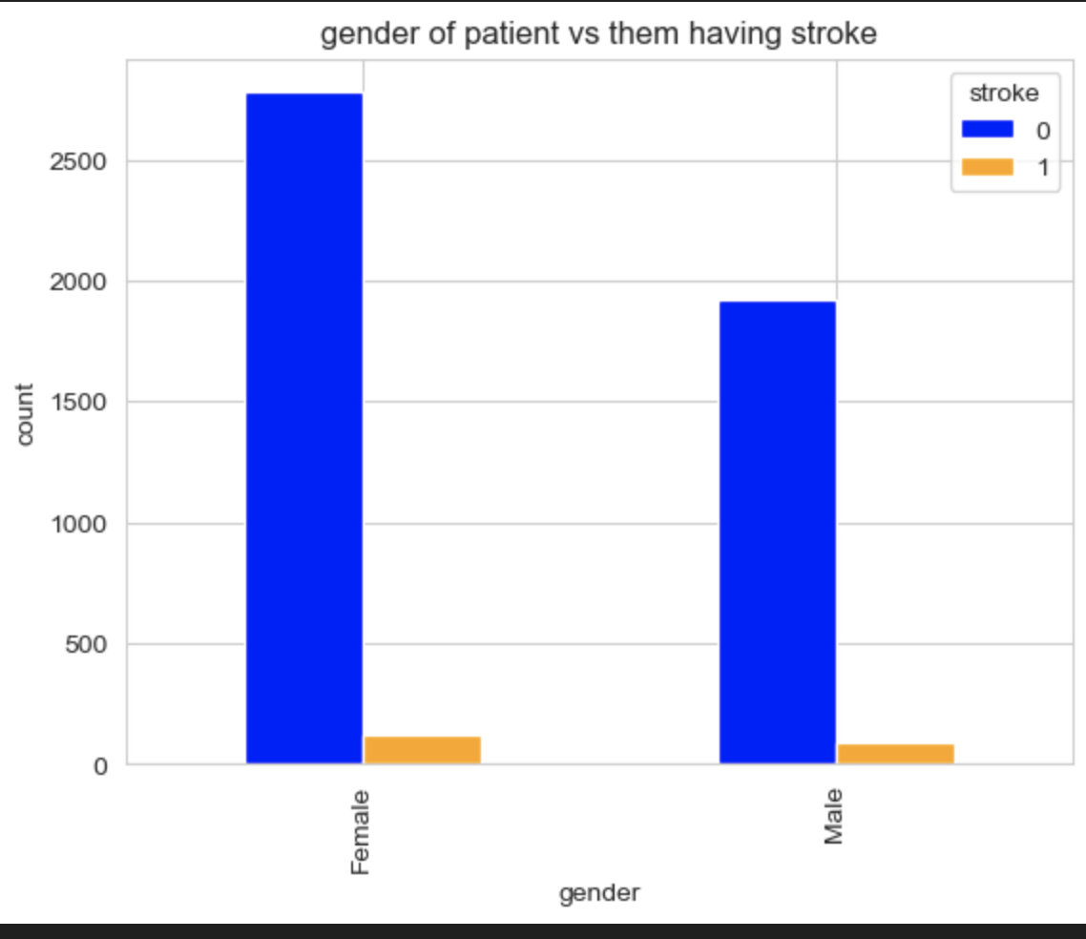
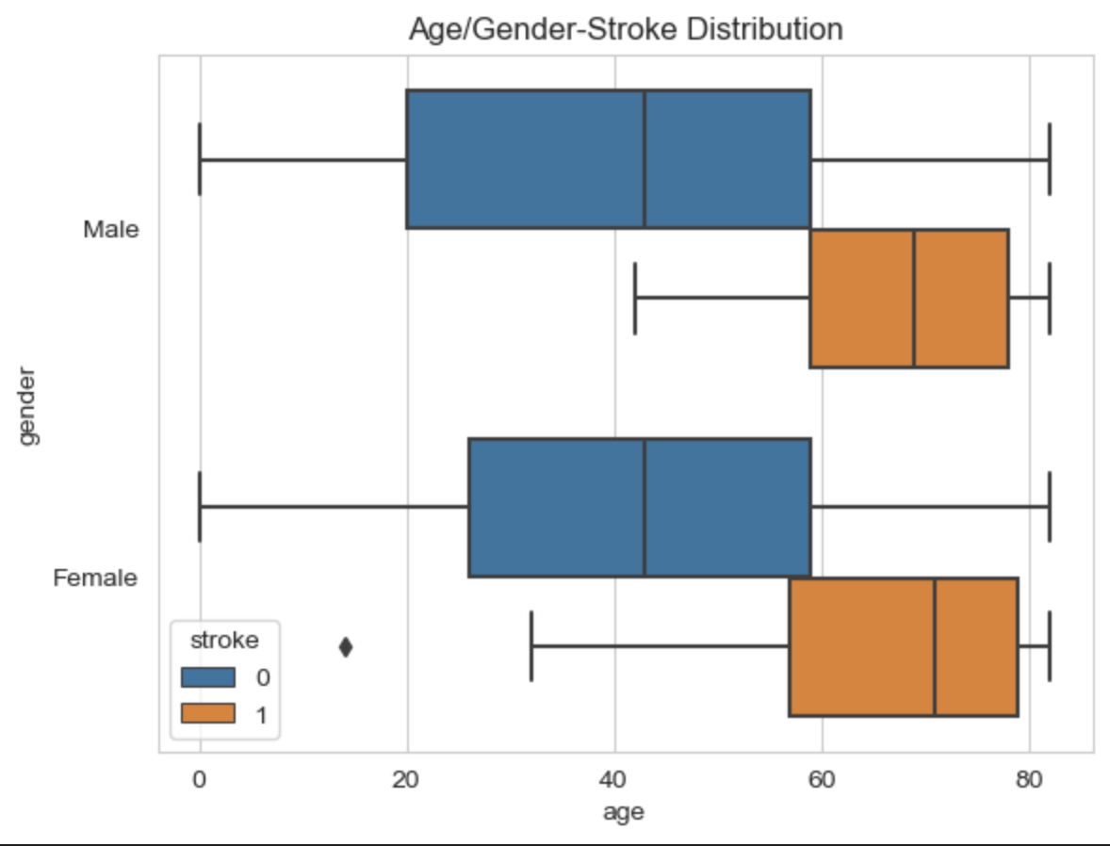
GENDER vs Stroke
Both females and males have similar proportion of stroke cases with males having slightly more.

Slide 9
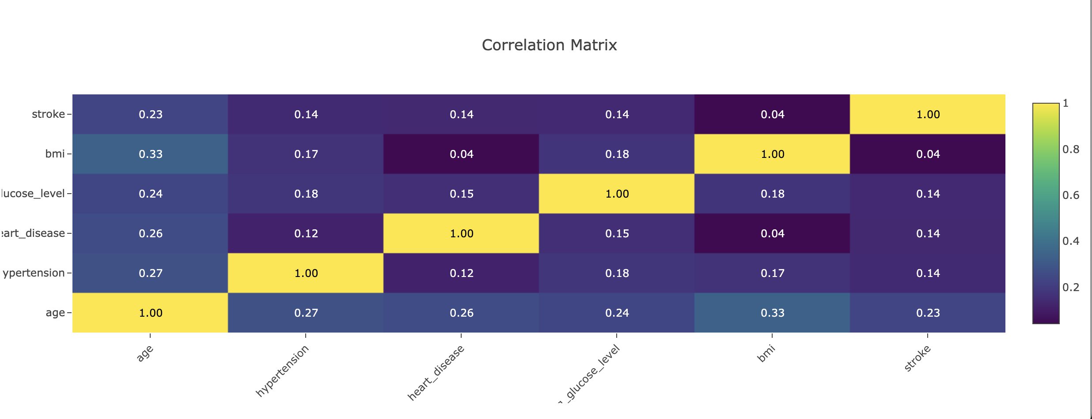
Correlation heatmap
Shows visualization of the correlation between all pairs of features in the dataset.
We examine the correlation with the target variable stoke
The age shows highest positive correlation with the stroke target variable. This suggest that older people might be at the higher risk of having a stroke.

Slide 10
Q1: ..samd.sadljlkjlkejqwlkejwlkqjelwelkjq
Analysis Approach
Visualization
Hypothesis
Library
DV

Slide 11
Q1: ..Continued
Analysis Approach
Visualization
Hypothesis
Library
DV

Slide 12
Q2: ..samd.sadljlkjlkejqwlkejwlkqjelwelkjq
Analysis Approach
Visualization
Hypothesis
Library
DV

Slide 13
Q2: ..Continued
Analysis Approach
Visualization
Hypothesis
Library
DV

Slide 14
Q3: ..samd.sadljlkjlkejqwlkejwlkqjelwelkjq
Analysis Approach
Visualization
Hypothesis
Library
DV

Slide 15
Q3: ..Continued
Analysis Approach
Visualization
Hypothesis
Library
DV

Slide 16
Discussion
+ Dashboard; demonstrate interactivity

Slide 17
Discussion
+ Dashboard; demonstrate interactivity

Slide 18
conclusion
Future direction
Limitations
Group Review

Slide 19


Thank you

Slide 20








Data loading
Data Cleaning

